Slide 1


Autonomous Intelligent Vehicle
Company Logo
By
Name of the Student
Apoorv Waghmare ECE 32
Chinmay More ECE 129
Atharva Vakharkar ECE 07
Internship Industry Name: Prescient Technologies
School of Electronics and Communication Engineering
MIT World Peace University, Pune
School Mentor Industry Mentor
Prof. Shweta Kukade Mr. Shridhar Patil

Slide 2
Agenda:
Company Logo
Project Title
Timeline
Introduction
Literature Survey
Project Description (Block Diagram, Explanation)
Software/Hardware (Used in project)
Results Screenshots
Tasks Completed till Date
Challenges And Solutions
Key Learnings till Date
Action Plan for the remaining term
Conclusion

Slide 3
Autonomous Intelligent Vehicle
Company Logo

Slide 4
Introduction:
Company Logo
Our Project is based on making autonomous intelligent vehicle, which can take decision on its own on which path it should travel and avoid any kind of obstacle if present on its path.
The single board computer (Raspberry Pi) would have a map of the room in which the vehicle is present. Starting co-ordinate of the bot will be fed by user, R-pi will collect and make all the necessary calculations and proceed to the destination.
These vehicles use laser, line/wire or magnet/barcode to move around the designated area.
Coming to this project we are planning to use optical encoders to find the direction and distance travelled by the bot and in future we can make use of LIDAR for further accuracy.

Slide 5
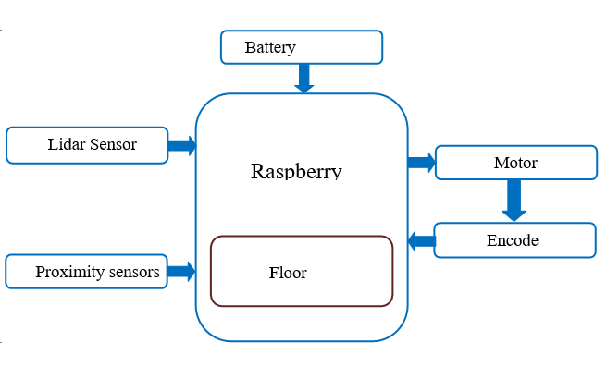
Block Diagram

Slide 6
Timeline:
Company Logo
1ST Phase:
Interfacing all components with Raspberry Pi. i.e. lidar and motors.
Designing Chassis on Solid Works.
Manufacturing the Chassis.
Keeping track of X-coordinates in 1-D motion.

Slide 7
Timeline:
2nd Phase:
Interfacing Lidar sensor with Raspberry Pi.
Optimised path finding between any two nodes.
Manufacturing the bot.

Slide 8
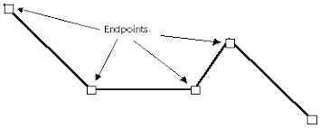
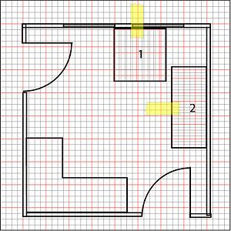
Timeline:
3nd Phase:
AIV can trace a polyline given to it.
AIV can scan and collect point cloud data and transform the points form local to global system.
AIV is be able to put a grid on a map and plan paths between the cells of the grid.

Slide 9
Literature Survey:
Company Logo
The aim of the literature survey is to distinguish between the existing projects and published products with their several approaches and methodologies that has been done in the field of AIV.
The knowledge of the existing technology is important for the proper design of any robotic system. Mechanical architecture, sensor technology and navigation control strategy are important fields to consider for the development of a mobile robot for any specific task.
In this literature survey we also studied about trends in autonomous vehicles, ways to achieve autonomy and lastly methods to solve the localization problem.

Slide 10
Literature Survey:
Company Logo
LIDAR SENSOR :
This paper tells us the role of lidar in sustainable forest management.
When considered within the context of all the measured and derived attributes required to complete a forest inventory, LiDAR can be a valuable tool in the inventory process.
LiDAR, airborne laser altimetry, forest inventory, height, volume, biomass, update, remote sensing.

Slide 11

Software/Hardware (Used Until Now):
Company Logo
Lidar Sensor
75 RPM DC motor with inbuilt encoders
Motor Driver IC
Raspberry Pi
Visual Studio
Code blocks
C++

Slide 12
Components (Used Until Now):
Company Logo
DC Geared Motor with Encoder 225 RPM:
Rated Voltage: 12 V
No-load Current: 70 mA
Rated Current: 410 mA
Rated Torque: 1.2 kg-cm
Shaft Diameter: 6 mm
Gear Ratio: 20:1

Slide 13
Components (Used Until Now):
Company Logo
Lidar Sensor : LIDAR, which stands for Light Detection and Ranging, is a remote sensing method that uses light in the form of a pulsed laser to measure ranges (variable distances) to the Earth . A LIDAR instrument principally consists of a laser, a scanner.
For our project we are using LIDAR for mapping and generating check points for the AIV.
LiDAR, similar in operation to RADAR, measures the distance between a sensor and target object by emitting a laser pulse which is partially reflected by the object, with the return measured using a receiver. The distance to the target object from the LiDAR platform is calculated by measuring the time taken for the pulse to return to the system

Slide 14
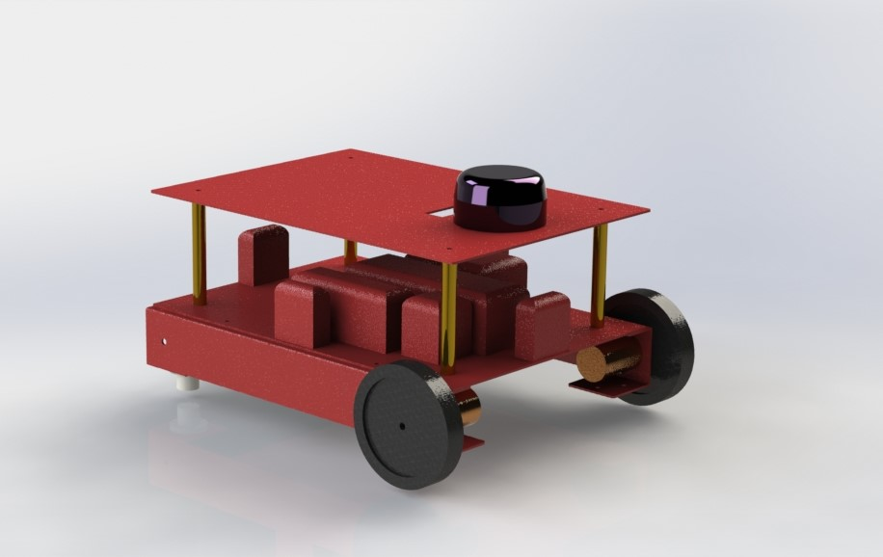
Result Screenshots:
Company Logo
CAD Model of Bot :

Slide 15
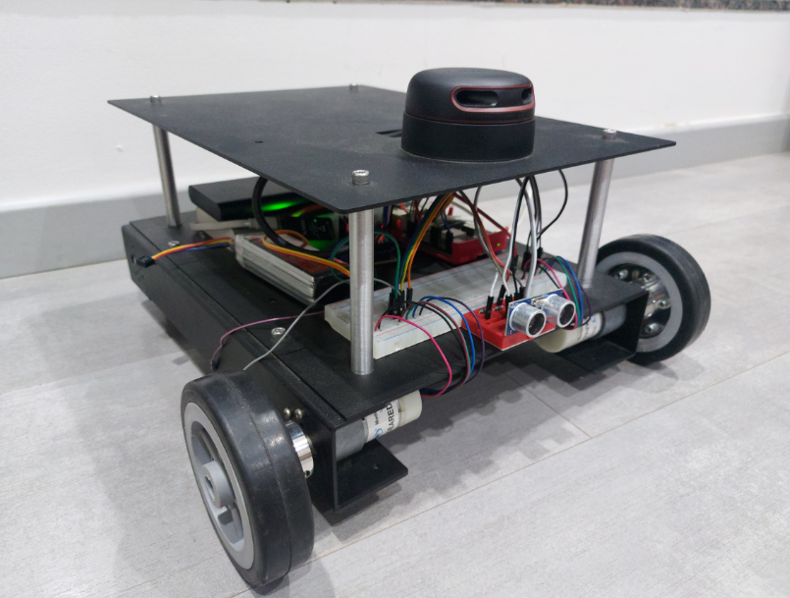
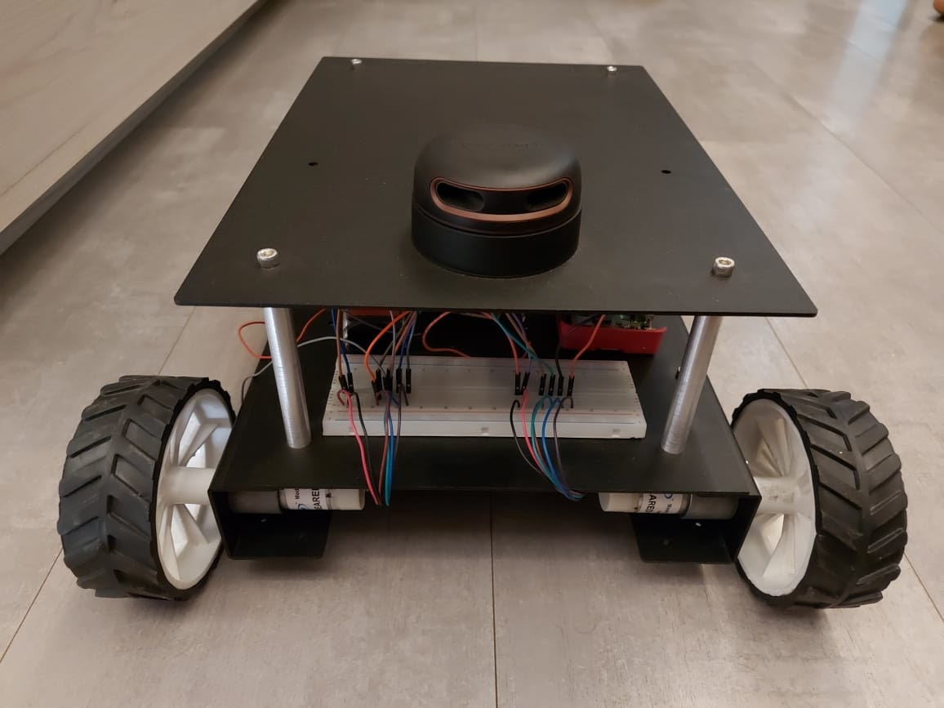
Result Screenshots:
Company Logo
Manufactured Bot :

Slide 16
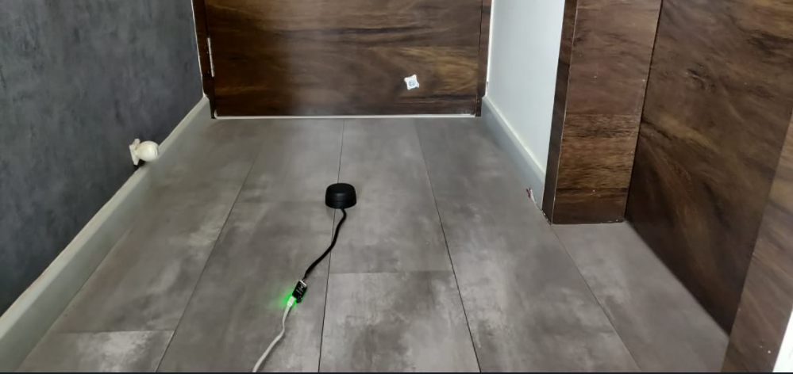
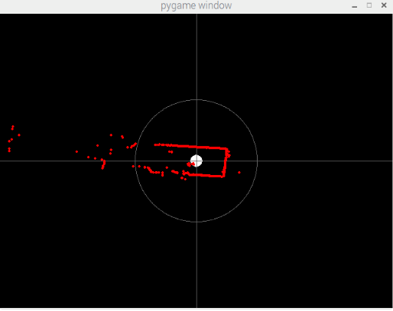
Result Screenshots:
Company Logo
Lidar Sensor output:

Slide 17
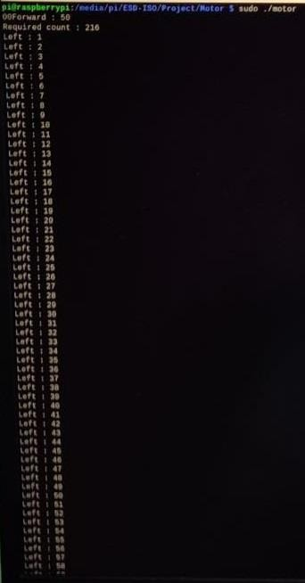
Result Screenshots:
Company Logo
Motor Encoder output:

Slide 18
Tasks Completed Last Term:
Company Logo
Project Requirements
Component Selection
Interfacing with Raspberry Pi
Chassis Design and Manufacturing
Testing for Lidar Sensor
TCP/IP protocol is used in our project

Slide 19
Map Building Process:
Company Logo
As we know that the main purpose of a map is navigation, in this phase we will discuss the process how a map is generated step by step.
For the initiation of this process we need to acquire the co-ordinates of vertices of the area of operation(warehouse) from the user.
The software then creates a polygon from the vertices.

Slide 20
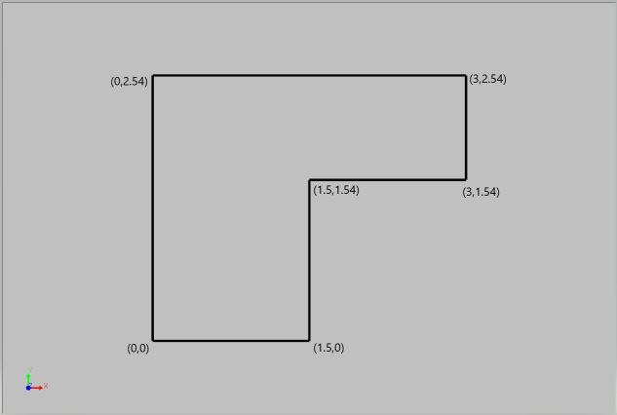
Map Building Process:
Company Logo
This is a map of polygon generated through following co-ordinates fed by the user : { (0,0) , (1.5,0) , (1.5,1.54) , (3,1.54) , (3,2.54) , (0,2.54) }

Slide 21
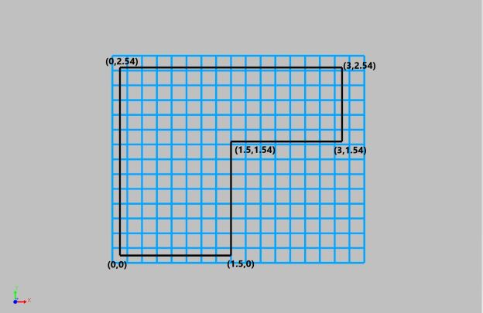
Map Building Process:
Company Logo
As shown in image above, we put a grid through the polygon of equal cell size which can be decided by the user.
Here we have used the cell size 20cm x 20cm.

Slide 22
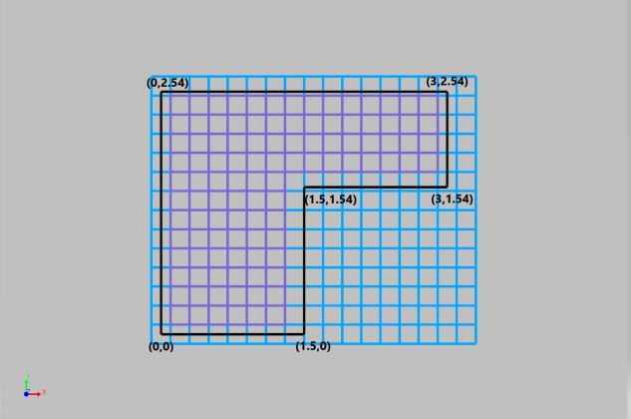
Map Building Process:
Company Logo
In the next stage, we only consider the cells lying completely inside the polygon and those which are outside the polygon are eliminated.
Here as we can see only the purple colored cells are valid.

Slide 23
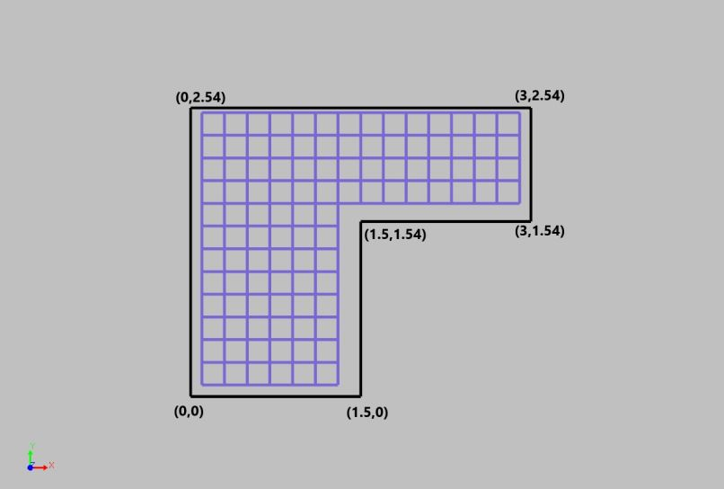
Map Building Process:
Company Logo
In this image we can see we have eliminated the invalid grid cells and we will only consider the purple (valid) grid cells for further processing.

Slide 24
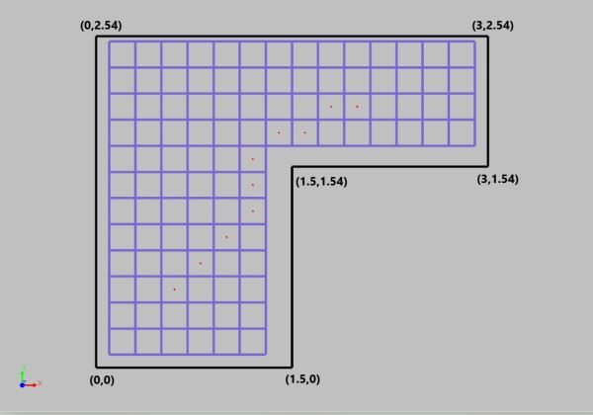
Map Building Process:
Company Logo
The user then chooses the destination cell for the bot through the GUI. The software then uses A* algorithm to draw a path from initial point to destination point by using cell by cell approach.

Slide 25
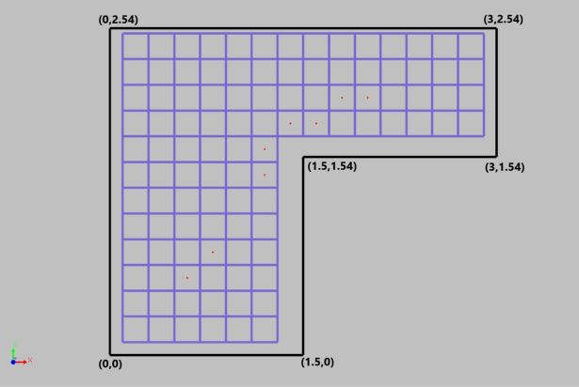
Map Building Process:
Company Logo
Now this path is further optimized by eliminating the less important cells along the path. For instance if the bot has to follow a long route without any turns, the in-between cells can be discarded and the bot can directly aim for the cell with change in directions.

Slide 26
Dynamic Map Updating Algorithm:
The Working environment will not be always constant , there will be some static ,semi-static obstacles present in the working area.
To overcome this we are using a feedback algorithm to keep the checks on this obstacles
This is done by constantly checking and updating the status of the active and inactive cells by the location of obstacles.

Slide 27
Vehicle Tracking using Motor Encoder:
We get omega(w) of each motor using encoded motors.
We find instantaneous velocity vector of each wheel individually.
Using this two velocity vectors we can find instantaneous velocity of the AIV.

Slide 28



Instantaneous Vector Formula’s

Slide 29
Tasks Completed This Term:
Company Logo
We tested the AIV by feeding it with pre-determined map and it was able to trace the polyline given to it.
AIV is be able to put a grid on a map and plan paths between the cells of the grid.
Tested code for mapping any area using lidar.
Implemented and tested A-star path finding algorithms.
Added proximity sensor to avoid accidents.

Slide 30
Key Learnings Till Date:
Company Logo
Manufacturing Processes for Designing a bot.
We learnt new methods like Laser cutting and water jet method for manufacturing our chassis.
Working of Lidar technology.
A-star algorithm
Cryptography
Localization using LIDAR

Slide 31
Applications:
Company Logo
Warehouses
This type of AIV for bigger vehicles are used to transport people at some of the airports
Many other types of AIV for transporting goods in big store houses.
Survey areas where it is difficult for humans to reach. e.g some hazardous parts at chemical plants.

Slide 32
Conclusion:
Company Logo
We did , literature survey , defined scope and objective of the project to be accomplished.
The project is currently in testing phase. The individual testing of hardware components i.e. encoder motors, Lidar sensor is completed and all components are working fine.

Slide 33
References:
Company Logo
[1] M A Wulder, C W Bater, N C Coops, T Hilker, J C White
https://papers.ssrn.com/sol3/papers.cfm?abstract_id=3604309
De Silva, V.; Roche, J.; Kondoz, A. Robust Fusion of LiDAR and Wide-Angle Camera Data for Autonomous Mobile Robots. Sensors 2018, 18(8), 2730; https://doi.org/10.3390/s18082730.
Bimbraw, Keshav. (2015). Autonomous Cars: Past, Present and Future - A Review of the Developments in the Last Century, the Present Scenario and the Expected Future of Autonomous Vehicle Technology

Slide 34
Thank-You!!!

